Slide 1
Software Testing Techniques

Slide 2
Software Testing
Testing is the process of exercising a
program with the specific intent of finding
errors prior to delivery to the end user.

Slide 3
Testability
Operability—it operates cleanly
Observability—the results of each test case are readily observed
Controllability—the degree to which testing can be automated and optimized
Decomposability—testing can be targeted
Simplicity—reduce complex architecture and logic to simplify tests
Stability—few changes are requested during testing
Understandability—of the design

Slide 4

What Testing Shows
errors
requirements conformance
performance
an indication
of quality

Slide 5


Who Tests the Software?
developer
independent tester
Understands the system
Must learn about the system,
but, will test "gently"
but, will attempt to break it
and, is driven by "delivery"
and, is driven by quality

Slide 6
Test Case Design
"Bugs lurk in corners
and congregate at
boundaries ..."
Boris Beizer
OBJECTIVE
to uncover errors
CRITERIA
in a complete manner
CONSTRAINT
with a minimum of effort and time

Slide 7

White-Box Testing
... our goal is to ensure that all
statements and conditions have
been executed at least once ...

Slide 8
Basis Path Testing
Next, we derive the
independent paths:
1
Since V(G) = 4,
there are four paths
2
Path 1: 1,2,3,6,7,8
3
4
Path 2: 1,2,3,5,7,8
5
6
Path 3: 1,2,4,7,8
Path 4: 1,2,4,7,2,4,...7,8
7
Finally, we derive test
cases to exercise these
8
paths.

Slide 9
Loop Testing
Simple
loop
Nested
Loops
Concatenated
Loops
Unstructured
Loops

Slide 10
Loop Testing: Simple Loops
Minimum conditions—Simple Loops
1. skip the loop entirely
2. only one pass through the loop
3. two passes through the loop
4. m passes through the loop m < n
5. (n-1), n, and (n+1) passes through
the loop
where n is the maximum number
of allowable passes

Slide 11
Black-Box Testing
requirements
output
input
events

Slide 12
Software Testing Strategies

Slide 13

Testing Strategy
unit test
integration
test
system
test
validation
test

Slide 14

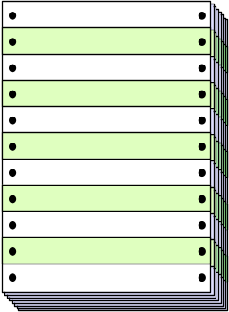
Unit Testing
module
to be
tested
results
software
engineer
test cases

Slide 15
Unit Testing
module
to be
tested
interface
local data structures
boundary conditions
independent paths
error handling paths
test cases

Slide 16

Integration Testing Strategies
Options:
  • the “big bang” approach
  • an incremental construction strategy

Slide 17

Debugging:
A Diagnostic Process

Slide 18
The Debugging Process
test cases
new test
cases
results
regression
tests
suspected
causes
corrections
Debugging
identified
causes

Slide 19
Debugging Effort
time required
to diagnose the
symptom and
determine the
cause
time required
to correct the error
and conduct
regression tests

